Slide 1
Recap
(1) What were we learning about when we read The Twits?
How Dahl uses humour and how he got ideas from his life for his stories.
(2) What incident in Dahl’s life inspired the writing of The Twits?
The Great Mouse Plot
(3) What was Mrs. Twit getting revenge for?
The frog prank.
(4) Is there any other connection between The Great Mouse Plot and the Twits?
Mrs. Pratchett seems similar in manner and appearance to Mrs. Twit.

Slide 2
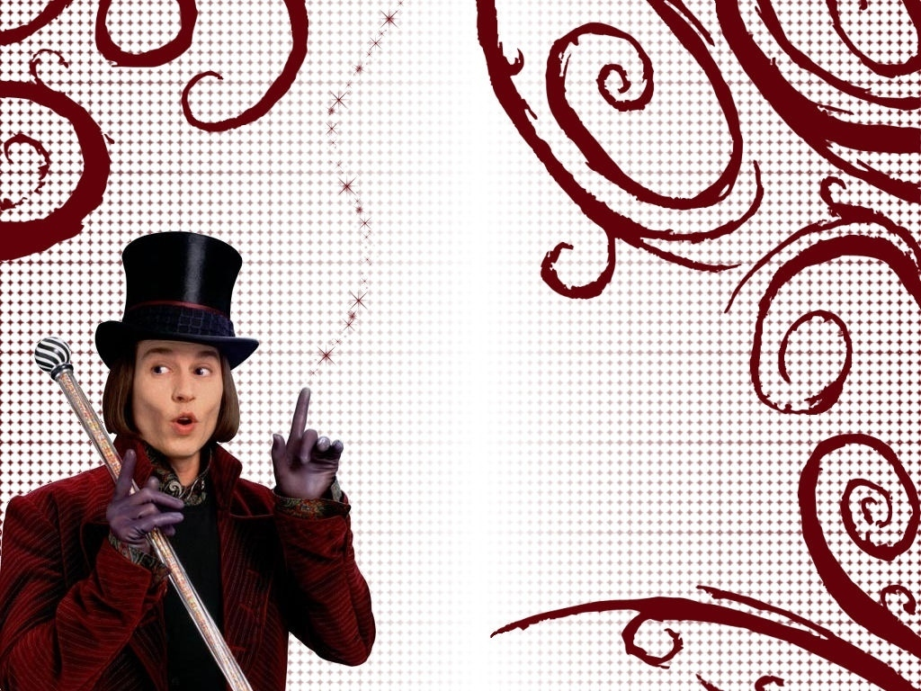
In today’s lesson we will be learning about:
descriptive language.
Using a Thesaurus

Slide 3
Charlie and the Chocolate Factory by Roald Dahl

Slide 4
What makes language descriptive?
Use of adjectives.
The cloudy sky is dark and dreary.
cloudy
dark
dreary
Use of adverbs.
Clouds sailed gracefully across the sky.
gracefully
Use of similes.
The sky is like a bowl of milk.
Use of metaphors.
The sky is a bowl of milk.
Thunder crashed and boomed in the
Use of onomatopoeia.
crashed
boomed
stormy sky.

Slide 5
What makes language descriptive?
6.
7.
descriptive verbs.
Clouds moved gracefully across the sky.
Clouds moved gracefully across the sky.
Clouds sailed gracefully across the sky.
descriptive nouns.
The man opened the door for the woman.
The man opened the door for the woman.
The gentleman gallantly swung the door open for the lady.

Slide 6
Descriptive Language Practice
In the following paragraph, underline the adjectives in blue, the adverbs in black, and the similes/metaphors in red.
The Monster by JK Rowling
Harry sniffed and a foul stench reached his nostrils – it was a mixture of old socks and rotting meat.
And then he heard low, heavy breathing, followed by a rumbling, then a low grunting and the shuffling footsteps of gigantic feet. Ron pointed into the darkness; in the black mouth of the passage, something huge and horrendous was moving towards him. He shrank into the shadows and watched as it emerged into a patch of moonlight. His heart pounded in his chest; he felt beads of sweat run down his back. His body froze with terror
It was a horrible sight. Twelve feet tall. Its skin was a dull, granite grey, its lumpy body like a boulder with its small, bald head perched on top like a coconut. It had short legs as thick as tree trunks with flat, horny feet. The smell coming from it was powerful and sickening. It was holding a huge wooden club, which it dragged noisily along the floor because its arms were so long.

Slide 7
Writing with the 5 Senses
Watch the Video
1. What are the five senses?
2. What can you do to concentrate when thinking about writing with your senses?
3. How can describing with your senses improve your writing?
4. What sense would you probably use to describe a piece of music?
5. Where can you look to find more adjectives?

Slide 8
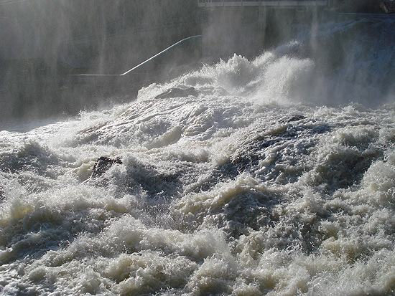
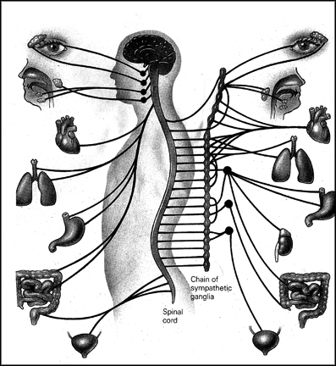
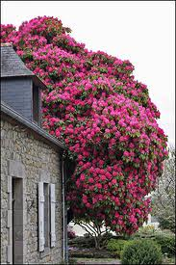
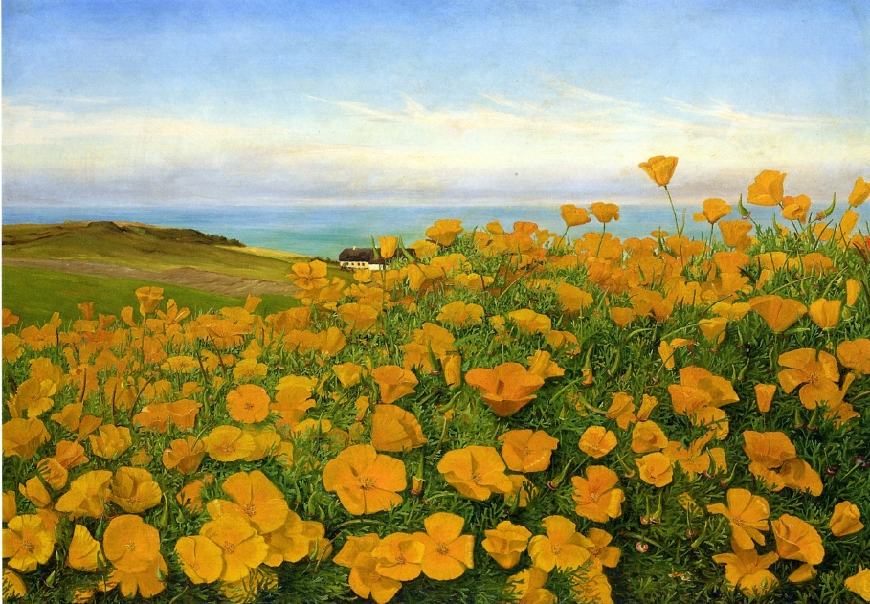
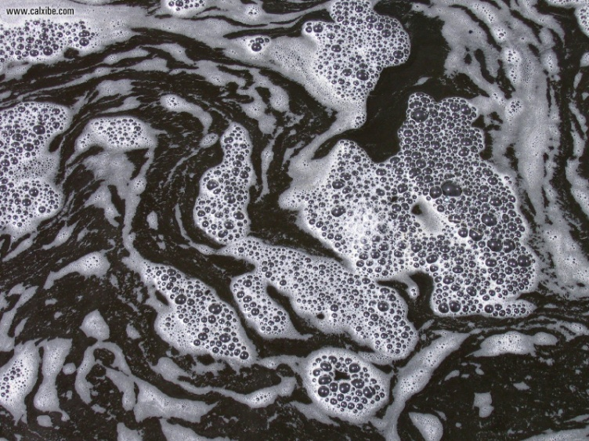
Vocabulary
churning
froth
rhododendrons
mauve
nerve centre
buttercups
E
B
D
F
A
C

Slide 10
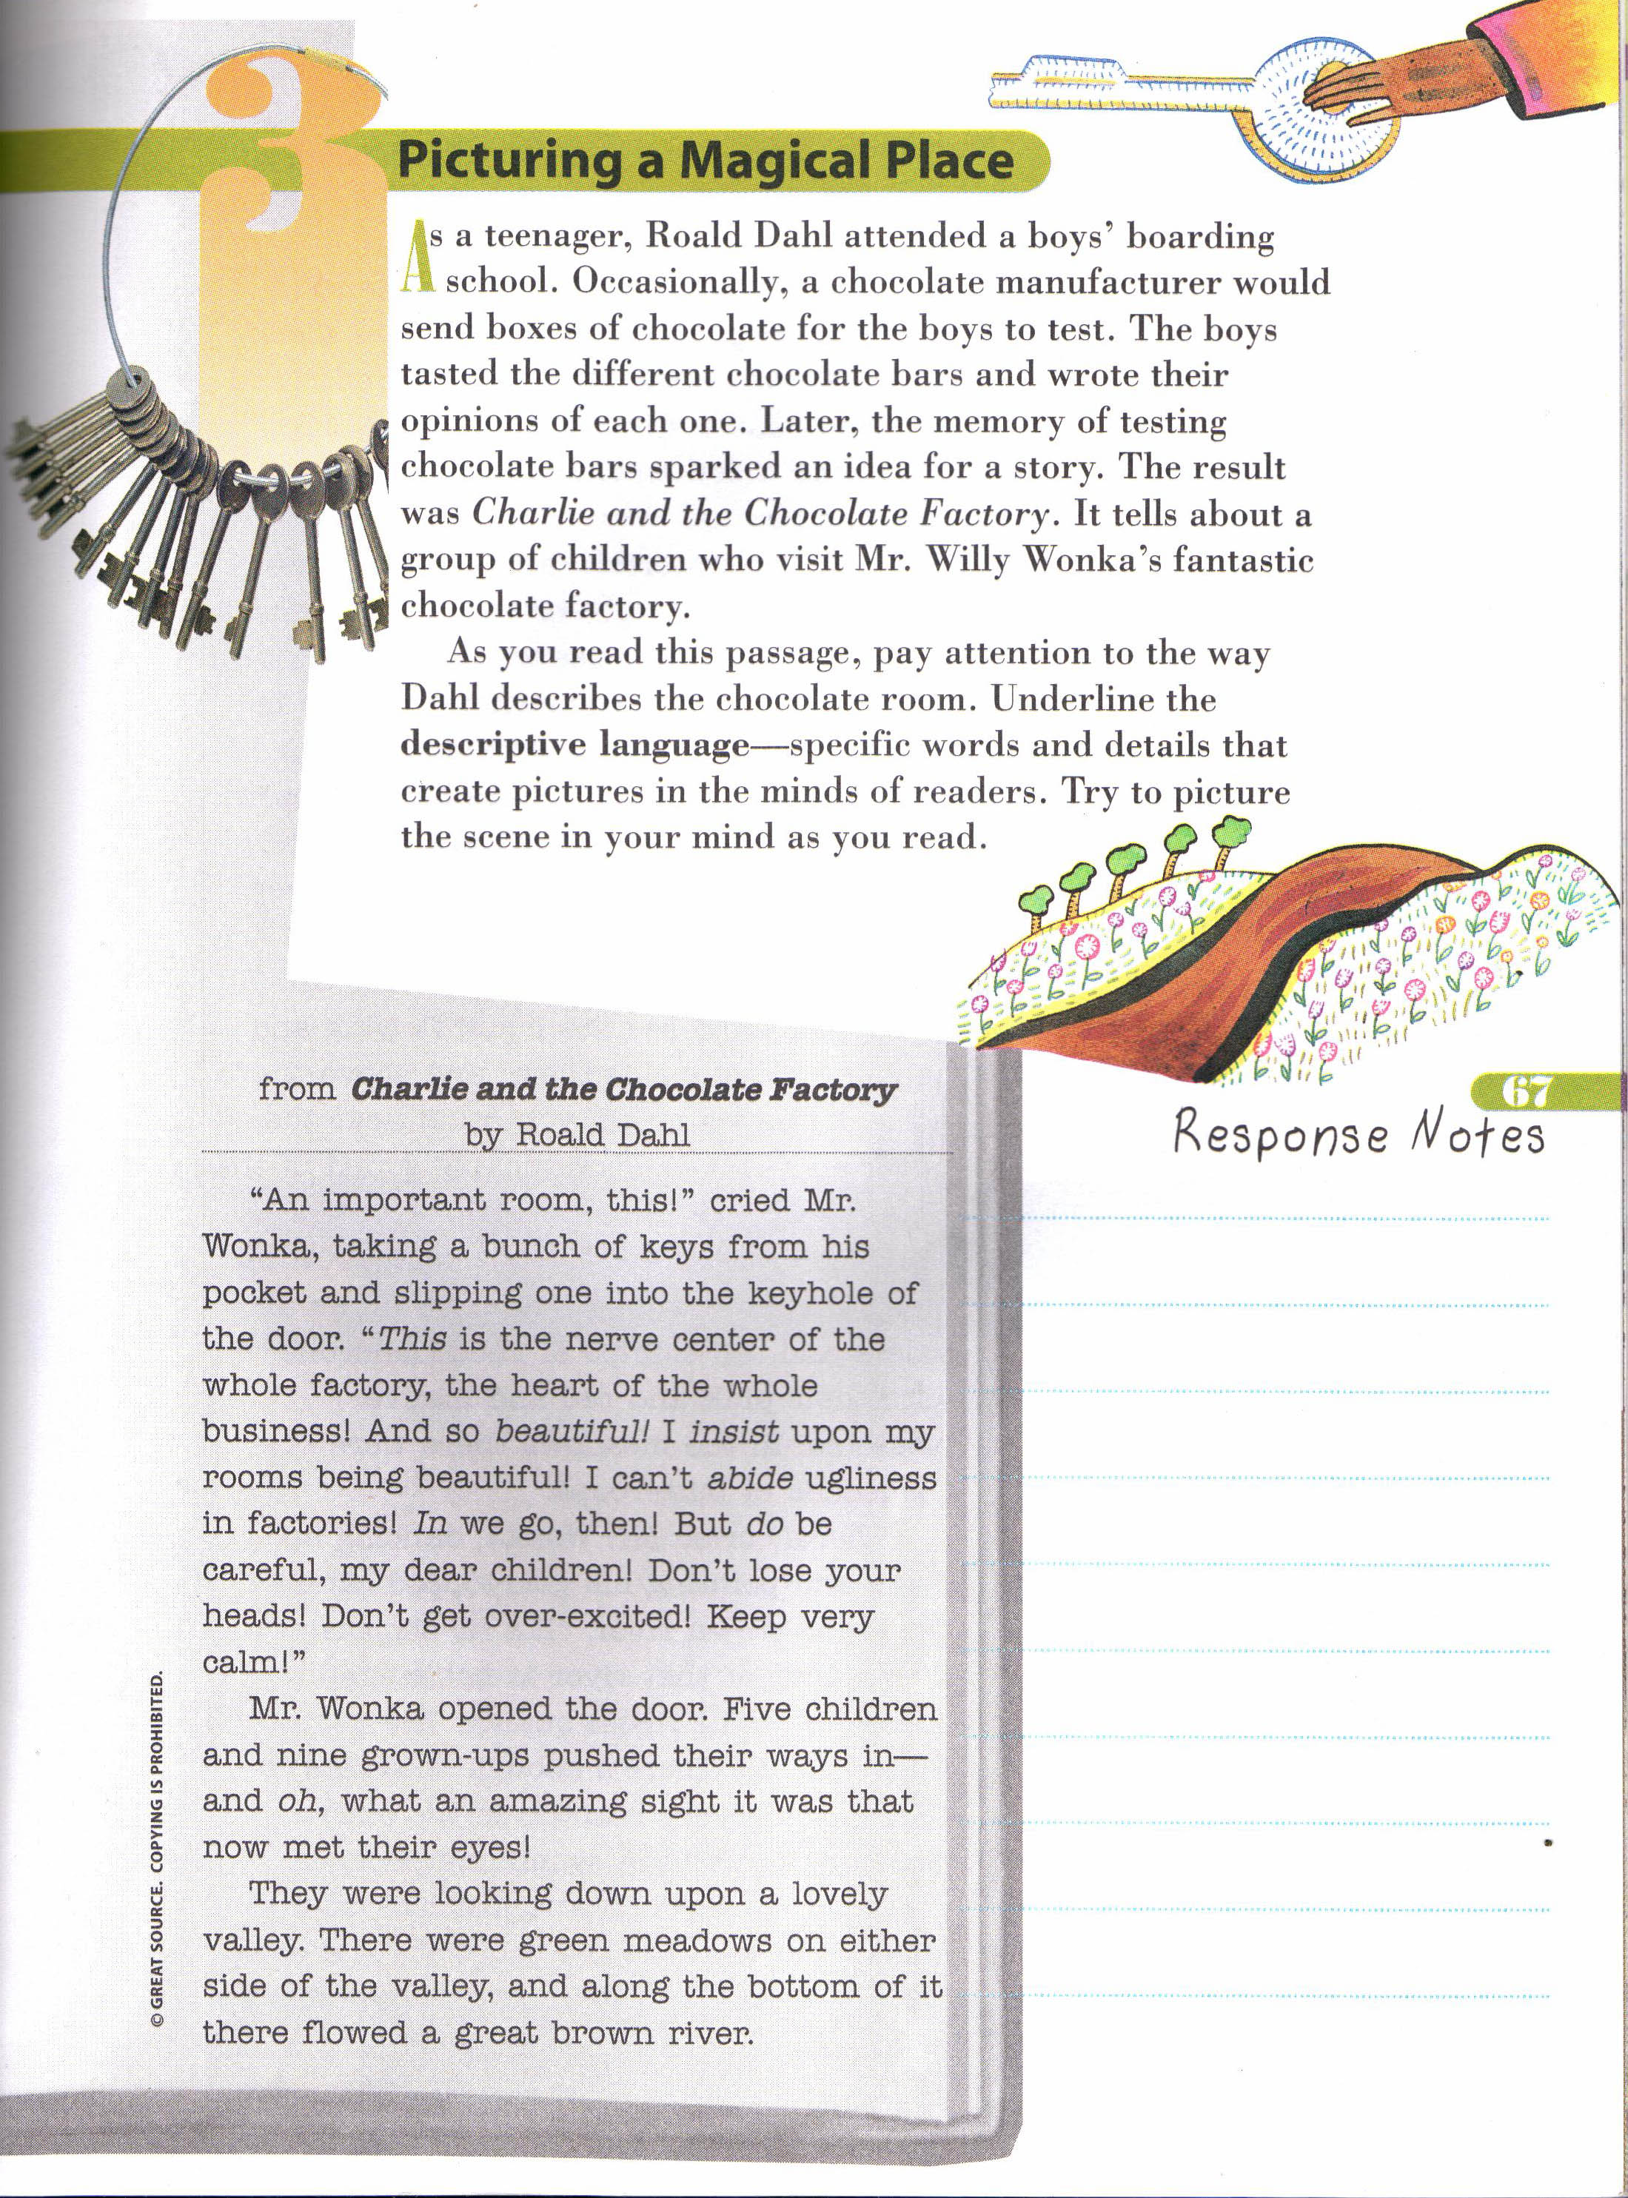

Slide 13
