Slide 1
G.T. English Sarah Cynthia Sylvia Stout Would not Take the Garbage Out Daybook: p.157 - 158 G.N. p.9 - 11

Slide 2
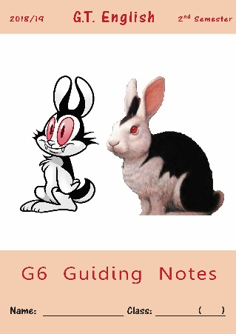
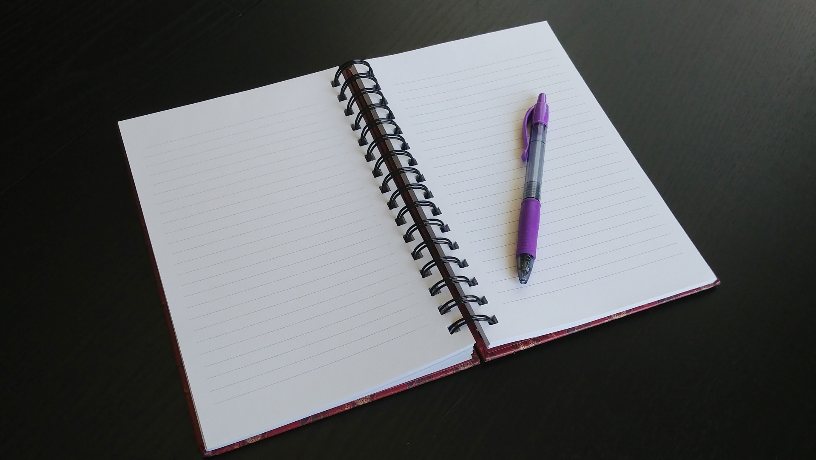
Open your Daybook
on page 157
Take out your Guiding Notes and open them on pages 8-9.
Make sure you have a notebook and a pencil
Notes:
Bell-Ringer or Do-Now Transitioning from the hallway into class can be a chaotic time. Use this slide to help students know what to expect as they come into the room, and change the instructions to fit your activity.
🍐 This is a Pear Deck Text Slide
🍐 To edit the type of question, go back to the "Ask Students a Question" in the Pear Deck sidebar.

Slide 3
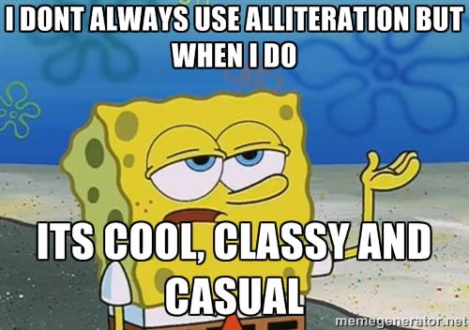
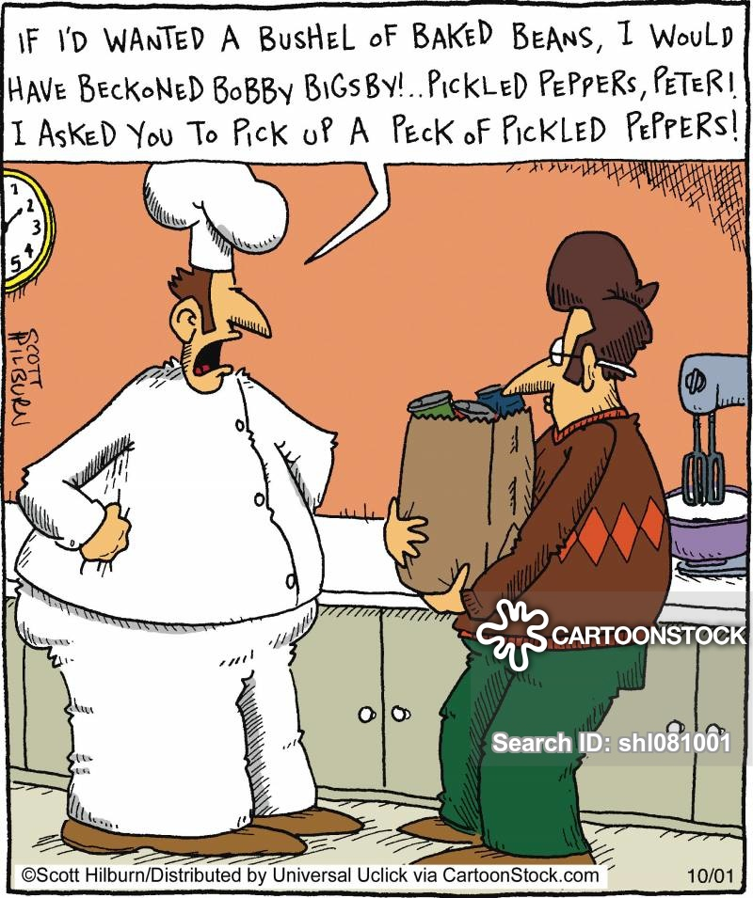
Review
What kind of rhyme
Is being used here?
Explain what
alliteration is…
it’s a kind of rhyme where multiple words in a line start with the same sound.

Slide 4
Alliteration

Slide 5
Any noise annoys an oyster,
But a noisy noise annoys an oyster more!
Tongue Twisters
https://youtu.be/oM67zj-IKOk

Slide 6
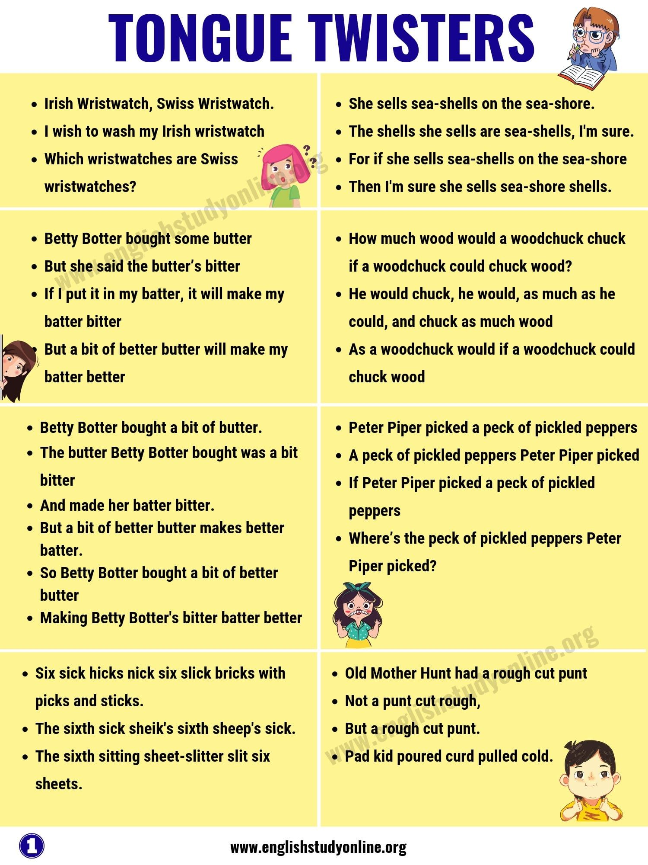
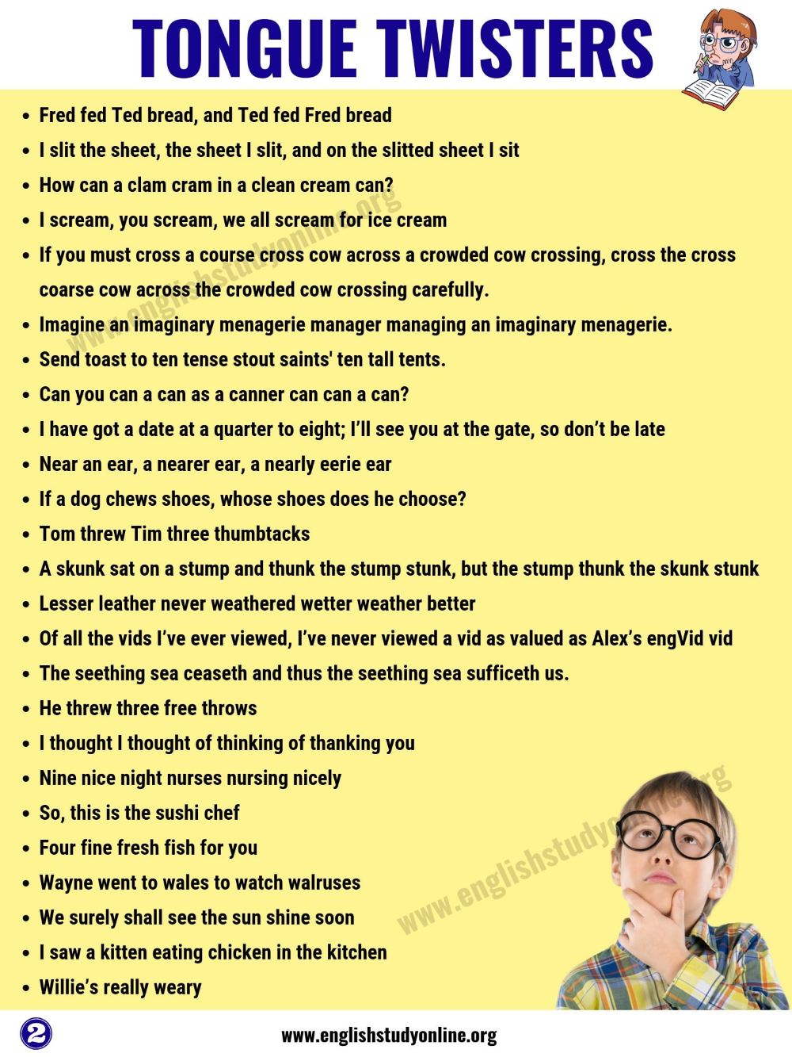

Slide 7
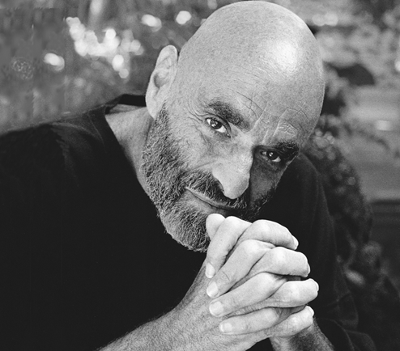
Review
Lets listen to
Shel Silverstein sing
the poem,
Sarah Cynthia Sylvia Stout
Would Not Take the Garbage Out

Slide 9
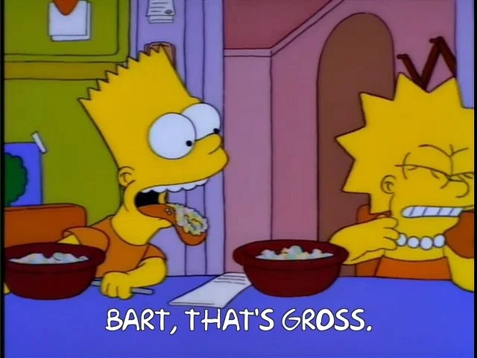
What feeling / emotion
Do many of the words in
This poem make
You feel?
Greasy napkins, cookie crumbs, Globs of gooey bubble gum, Cellophane from green baloney, Rubbery blubbery macaroni,
revulsion, disgust?

Slide 10
Review
What kind of literary device is being used here?
Explain what hyperbole is…
exaggeration when used in literature
used to make or emphasize a point.

Slide 11
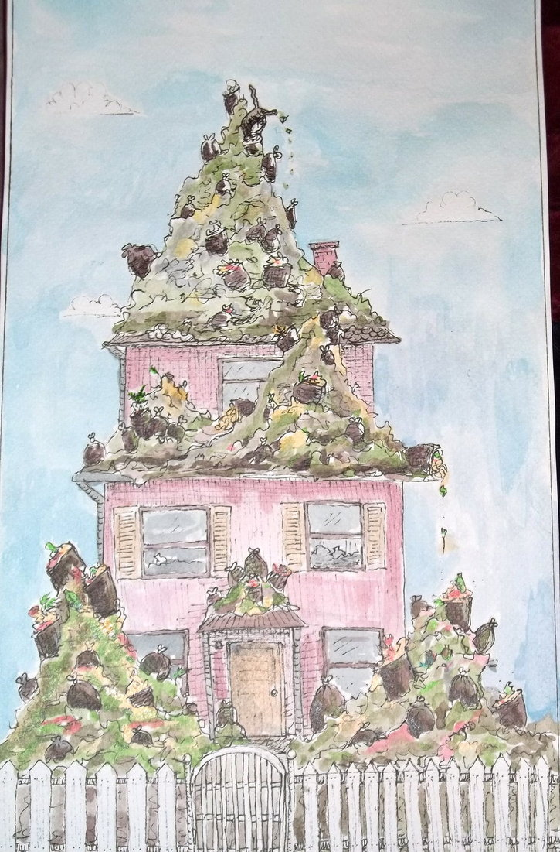
Review
What hyperbole do you
see in this poem?
the garbage broke the walls.
the garbage reached the sky.
The garbage stretched across North America from New York to San Francisco
That the garbage killed Sarah Stout
What point is Shel Silverstein
Trying to make?
the garbage / pollution problem in America was very serious
that there will be harmful consequences if they don’t deal with this problem soon enough.

Slide 12
In today’s lesson:
We will learn to tell the difference between details and sensory details
We will learn come up with details & sensory details that we will use later in our own sensory poem.

Slide 13
Read the following two paragraphs.
Then we will discuss which is more interesting and why.
Text A
Text B
As I approach the beach, I begin to hear the gentle splashing of the waves and I can smell the salty freshness of the sea on the breeze. I step more lightly , more quickly and with a joyous bounce. Once there, I’m greeted with the jubilant uproar of children tossing balls, dogs barking playfully, splashing swimmers giggling, and shrieking with uproarious laughter.
I like to go to the beach. There is a lot of sand and some trees there. There are only small waves on the ocean today. A lot of people like to play games on the beach and some are playing with balls in the water. They look and sound happy. There is also a lifeguard post with an emergency boat as well as change rooms and a number of restaurants.
Which text contains more details about the beach?
Which text is more descriptive?

Slide 14
GN pg. 8

Slide 15
GN pg. 9

Slide 16
Homework:
GN pages 8 – 9
Due: tomorrow by 12:00 noon
Submit through eClass

Slide 17
In Today’s lesson we learned:

