Slide 1
G.T. English What is Trouble? Daybook: p.161 - 164 G.N. p.11 - 13

Slide 2
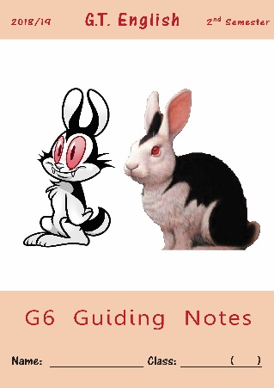
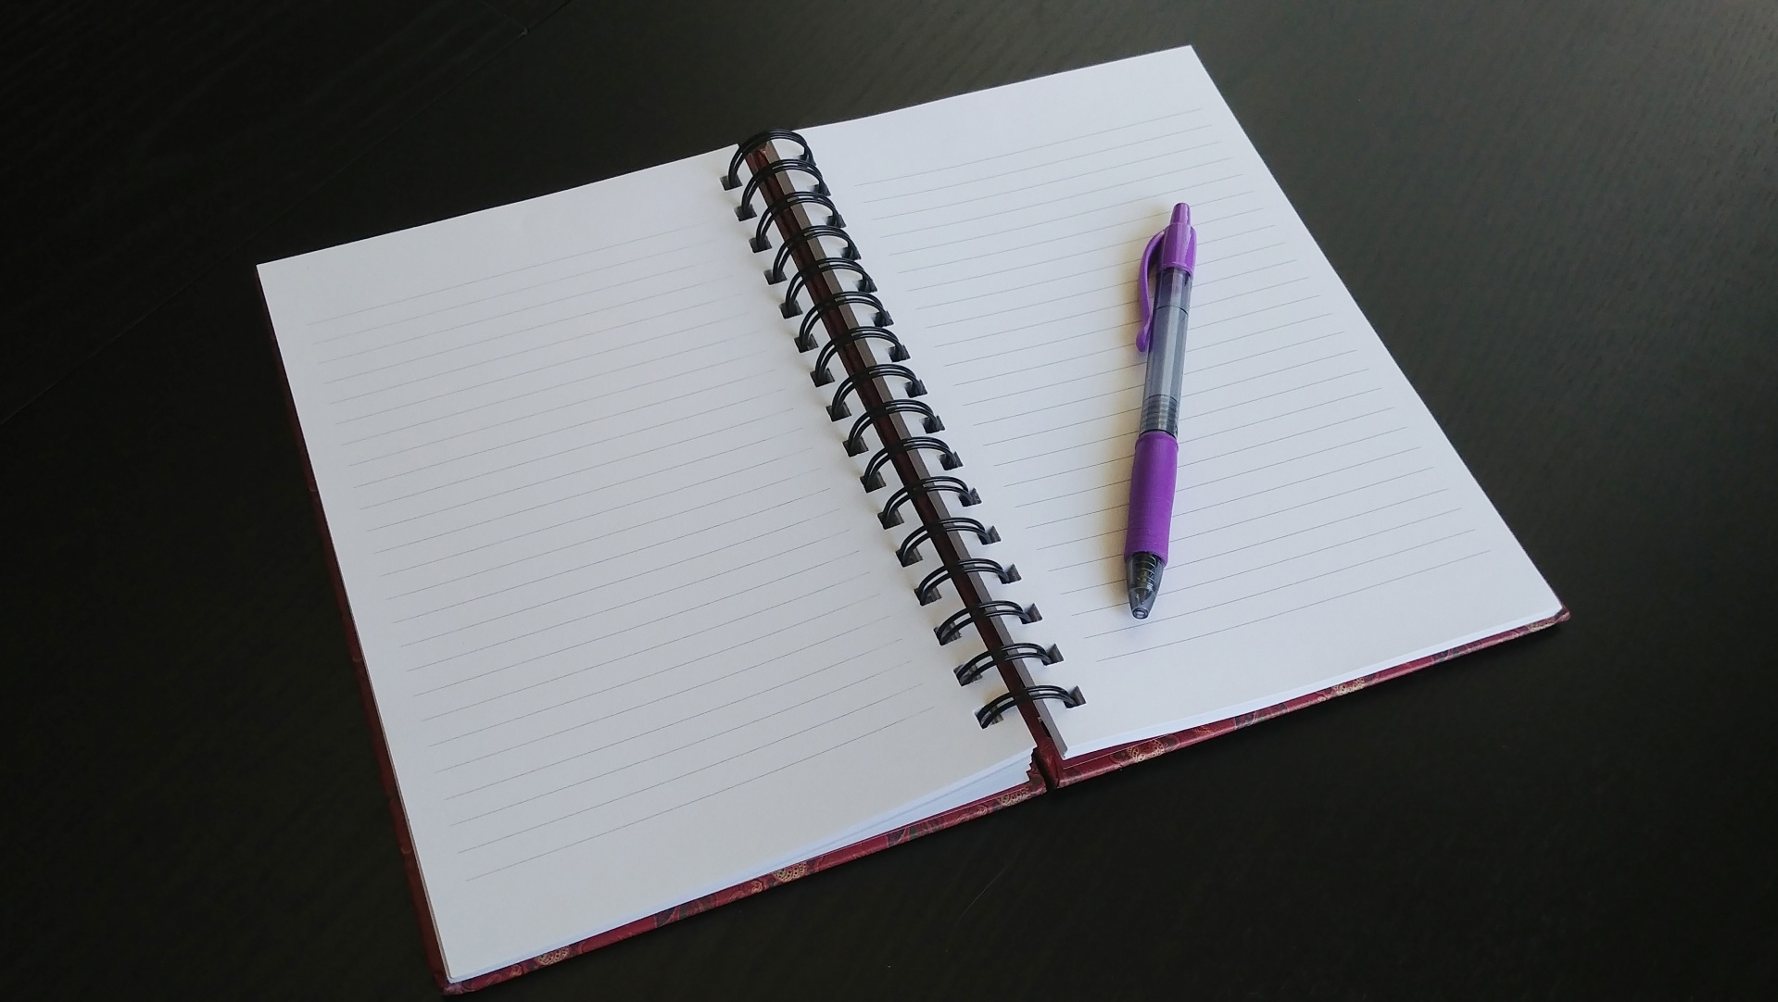
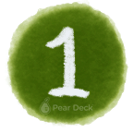
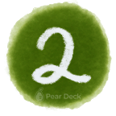
Open your Daybook
on page 161
Take out your Guiding Notes and open them on pages 11-13.
Make sure you have a notebook and a pencil
Notes:
Bell-Ringer or Do-Now Transitioning from the hallway into class can be a chaotic time. Use this slide to help students know what to expect as they come into the room, and change the instructions to fit your activity.
🍐 This is a Pear Deck Text Slide
🍐 To edit the type of question, go back to the "Ask Students a Question" in the Pear Deck sidebar.

Slide 3
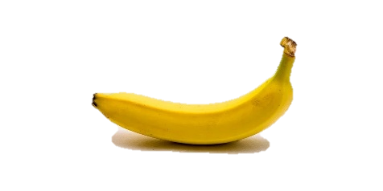
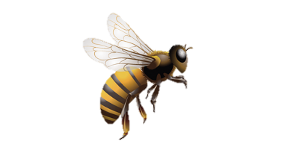
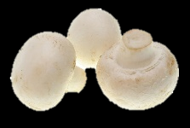
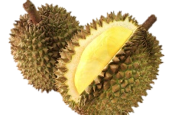
Review:
When more than 1 word in a line starts with the same sound it’s called, __________.
alliteration
If you want to find synonyms us a, _________.
thesaurus
____________ is a great multipurpose online word tool recommended by Mr. du Preez.
Detail | Sensory Detail
yellow, elongated, with a fruity smell
Black & yellow striped, small, makes a buzzing sound
small, white, button shaped on a short stem, with an earthy smell
hard, spiky skin with creamy, yellow flesh, with an unusual fruity smell

Slide 4
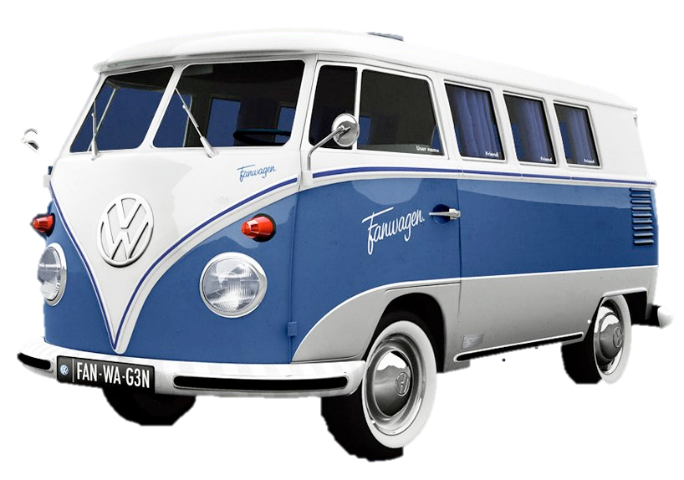
In today’s lesson:
We will learn about folktales.
We’ll also learn about how important it is to know something about the background of a story in order to understand it.
What is a folktale?
What brand of automobile is this?
Volkswagen
people
car
…which is German for ‘people’s car’

Slide 5
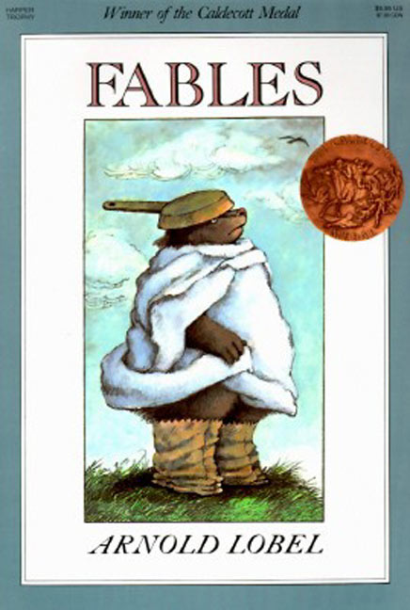
So a folktale is…
the People’s Story – or a story of the people.
Folktales (or folk tales) are stories passed down through generations, mainly by telling. (oral stories)
Different kinds of folktales include fairy tales (or fairytales), tall tales, trickster tales, myths, and legends.
Do you remember a kind of folktale that you studied in Grade 5?
fables are a kind of folktale

Slide 6
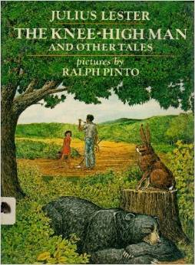
We are going to study a folktale that was interpreted and written down by Julius Lester.

Slide 7
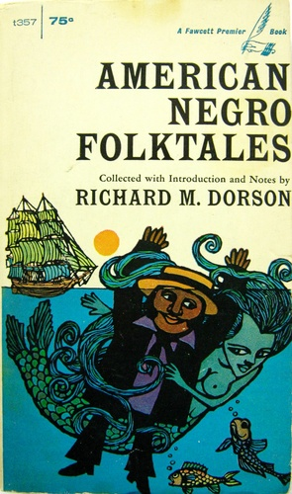
The same story (written and interpreted somewhat differently) can be found in this book by a different author.

Slide 8
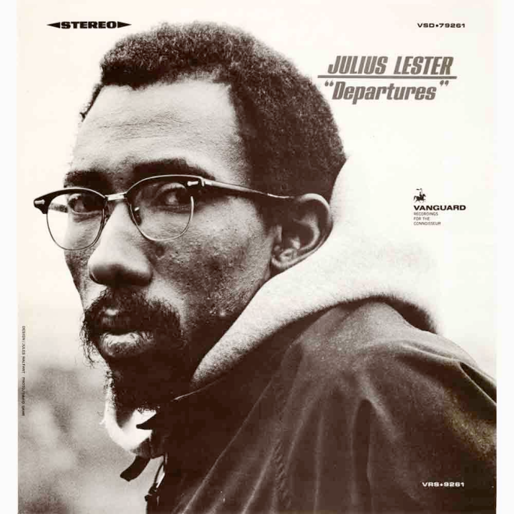
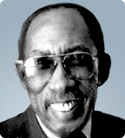
“…my first book for children was To Be a Slave. My interest in slavery was personal because three of my great-grandparents had been slaves. The need to know more about my individual past led me to begin studying slavery, and once I did, my interest grew and I became intrigued by the challenge of trying to imagine what it was like to have been a slave. I wanted to communicate to others that those we call slaves were really human beings, human beings pretty much like us.
I suppose I write because I have some questions I need answers to, and the only way I know to find the answers is to write my way into them. My advice for someone who wants to be a writer is to read, read, read. It is important to know what others have written. It is important to learn the possibilities of things to write about and the ways to write about them. There is no substitute for reading everything you can get your hands on."
“…my first book for children was To Be a Slave. My interest in slavery was personal because three of my great-grandparents had been slaves. The need to know more about my individual past led me to begin studying slavery, and once I did, my interest grew and I became intrigued by the challenge of trying to imagine what it was like to have been a slave. I wanted to communicate to others that those we call slaves were really human beings, human beings pretty much like us.
I suppose I write because I have some questions I need answers to, and the only way I know to find the answers is to write my way into them. My advice for someone who wants to be a writer is to read, read, read. It is important to know what others have written. It is important to learn the possibilities of things to write about and the ways to write about them. There is no substitute for reading everything you can get your hands on."
adapted from: http://www.scholastic.com/teachers/contributor/julius-lester

Slide 9
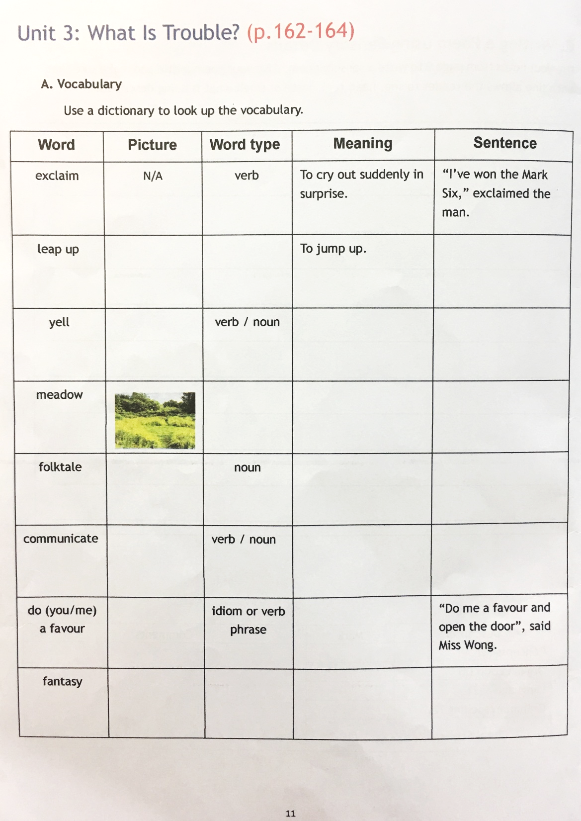
Vocabulary
Do
GN. pg 11

Slide 10
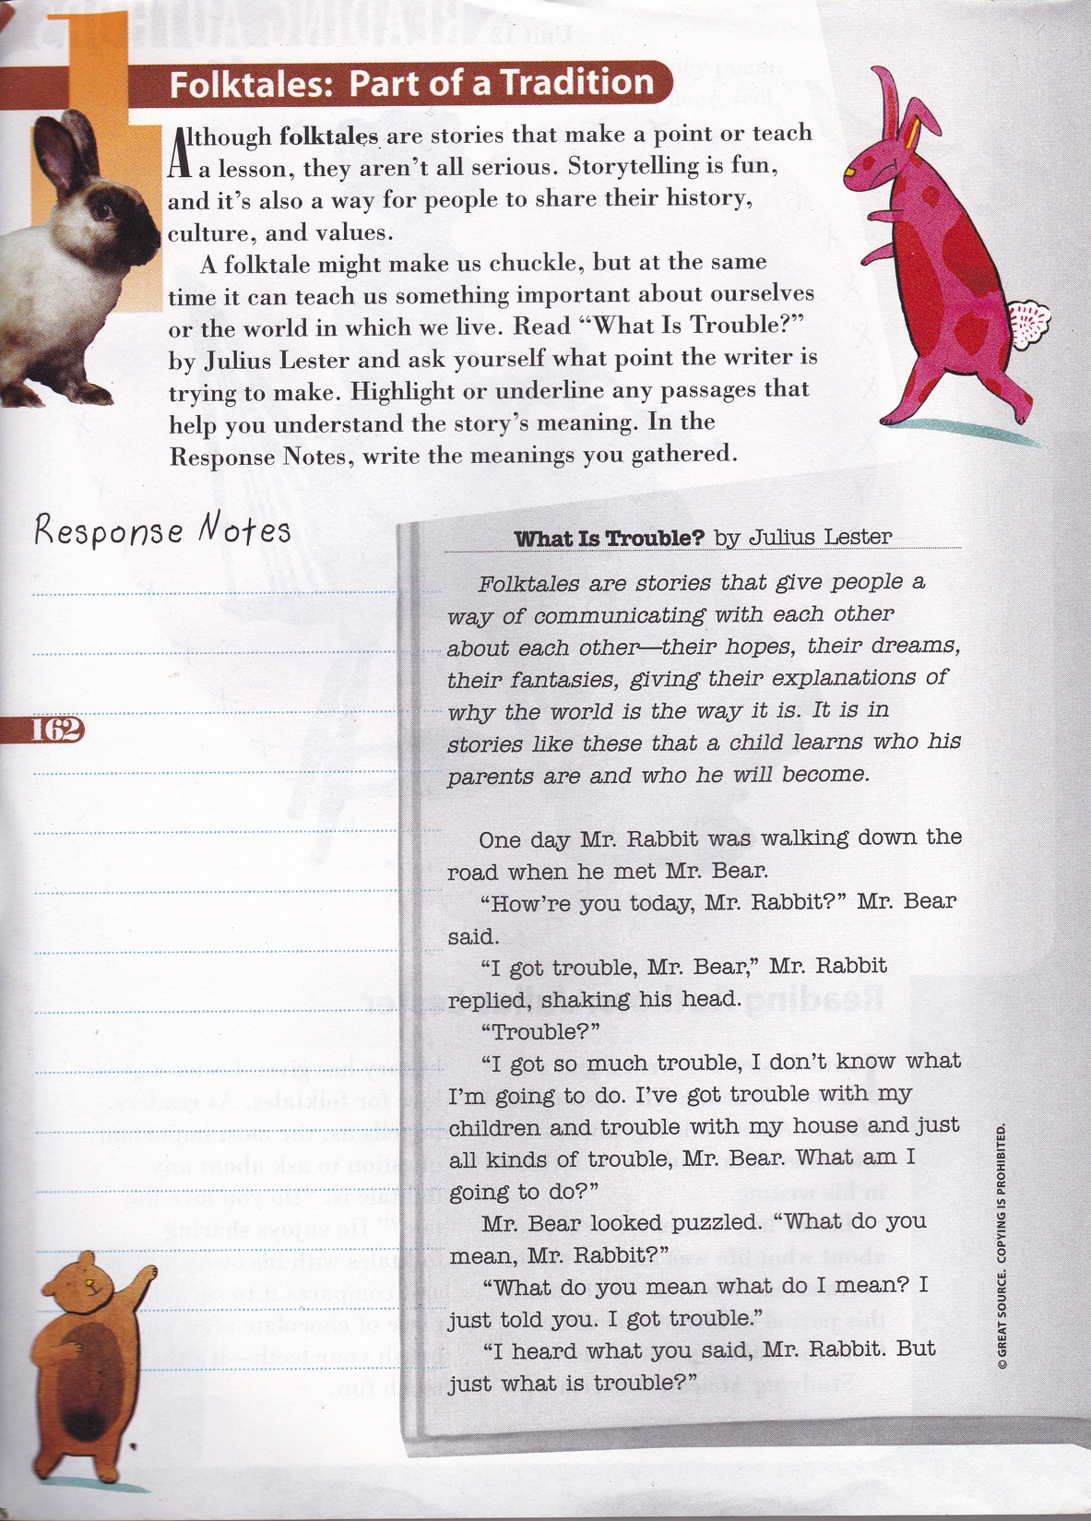
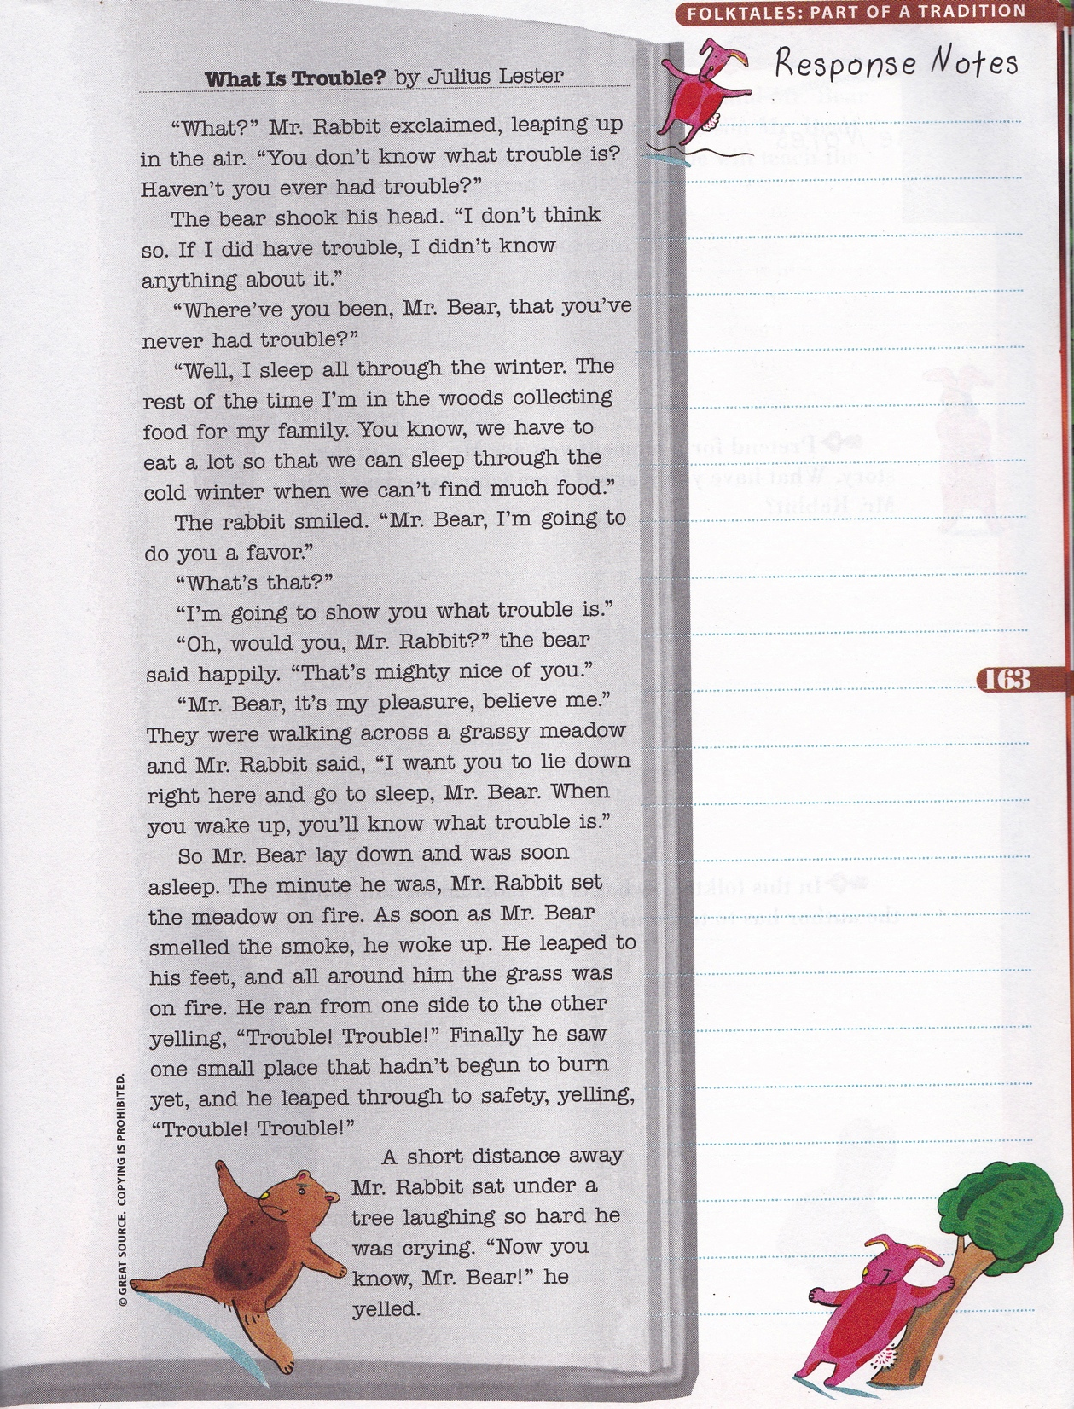
Link to story ppt.

Slide 11
So, what do you think the story means?

Slide 12
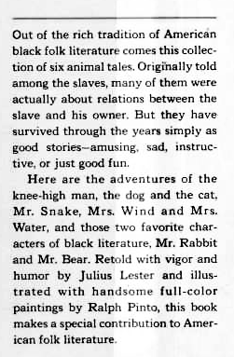
Read the book leaf on the right.
Now, what do you think the story means?
In this story, which character represents the black slave and which represents the white slave owner?
Discuss in your groups and be ready with good reasons to back up your position

Slide 13
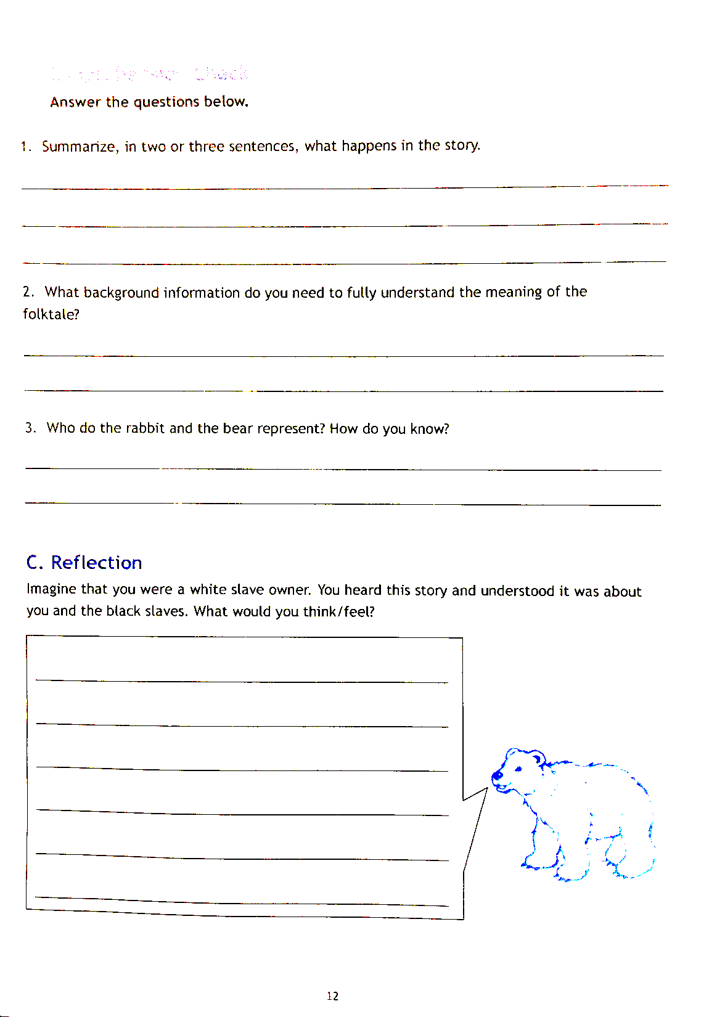
GN. pg 12
So, what do you think the story means?

Slide 14
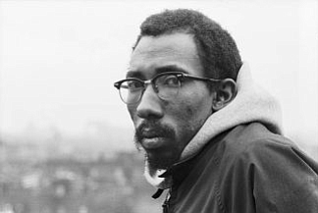

Slide 15
In Today’s lesson we learned:
Folktales are ‘the people’s stories’
Folktales were once oral stories passed down from generation to generation.
Sometimes we MUST know the cultural background of a story in order to be able to understand it.

Slide 16
Homework:
GN. Pp 11-12
Due tomorrow by 12:00 noon

